Slide 1
MIKE 11 Getting Started
Notes:
This powerpoint is optional.
Fill in the information relevant for your training course (location, date, type for M11 training, etc..)

Slide 2
SOFTWARE INSTALLATION
Products: MIKE 11 (MIKE Zero)
Version: 20xx Service Pack x
Licenses: local DHI license to be installed
Make sure you have installed the right products and version
Contact us if you are missing an installation or service pack
Installation DVD will be available at the course
Notes:
Again, just fill in the information according to your training

Slide 3
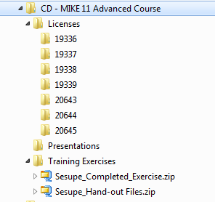
FILE STRUCTURE
Notes:
Make a screen dump of the folder structure of the files you give the participants.

Slide 4
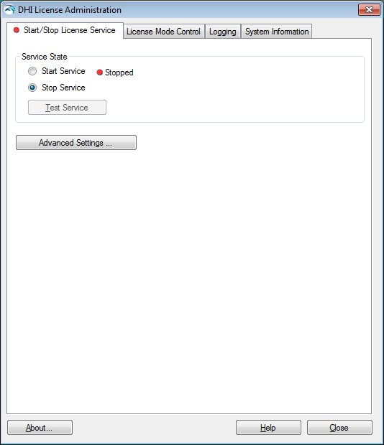
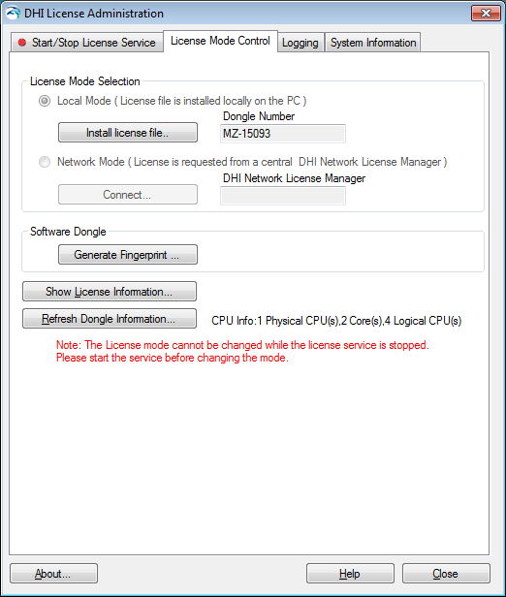
REGISTERING DHI LICENSE
Start > All Programs > MIKE by DHI 20xx >DHI License Administration
Choose the license mode and browse to the appropriate dhilicense.dat file
Note that you do not have the dongle yet. The dongle will be available at the training course

Slide 5
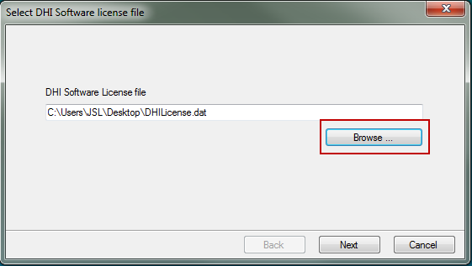
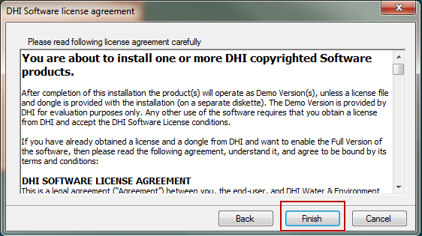
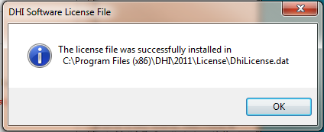
REGISTERING DHI LICENSE
Browse to your license file (sent by email)

Slide 6
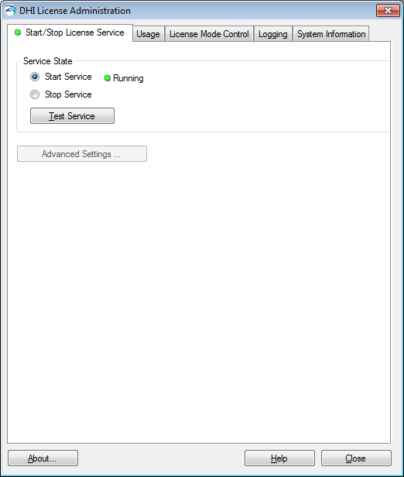
REGISTERING DHI LICENSE
Get back on the Start/Stop License Service page and Start Service again.
You can test the service however the test won’t be successful as you are missing the dongle
You can close the DHI License Administration

Slide 7
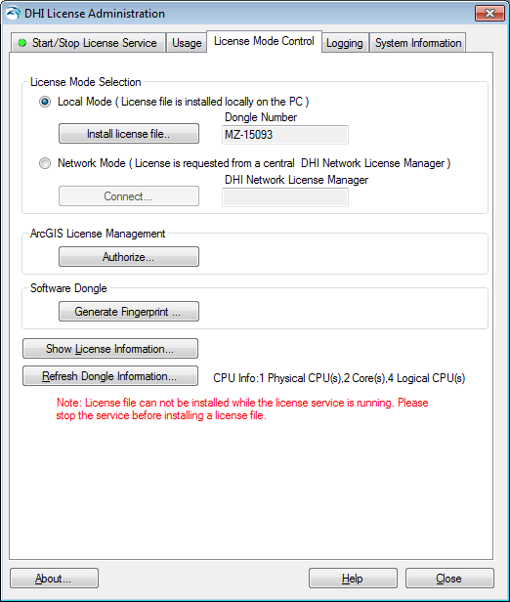
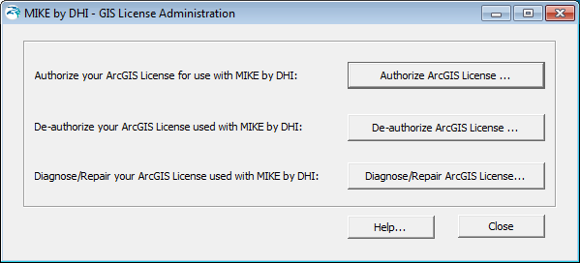
REGISTERING ARCGIS LICENSE

Slide 8
ARCGIS LICENSE
Choosing the ArcGIS license type
License type usually specified during installation
e.g. ArcEditor (Single Use)
If you want to change the license type (or if you’ve de-authorised the ArcGIS license in the DHI License Administrator):
Start, All Programs >MIKE by DHI 20xx > MIKE URBAN > ArcGIS Desktop Administrator
Then authorise the license via the DHI License administrator (not via the ArcGIS Desktop Administrator)

Slide 9
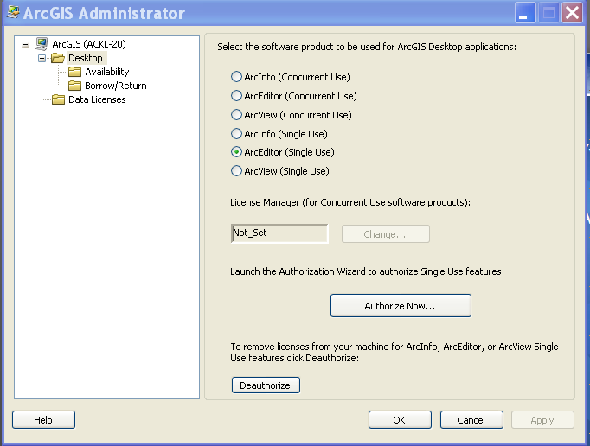
ARCGIS LICENSE
Choosing the ArcGIS license type

Slide 10
STARTING MIKE URBAN
From Start > All Programs > MIKE by DHI 20xx > MIKE URBAN

Slide 11
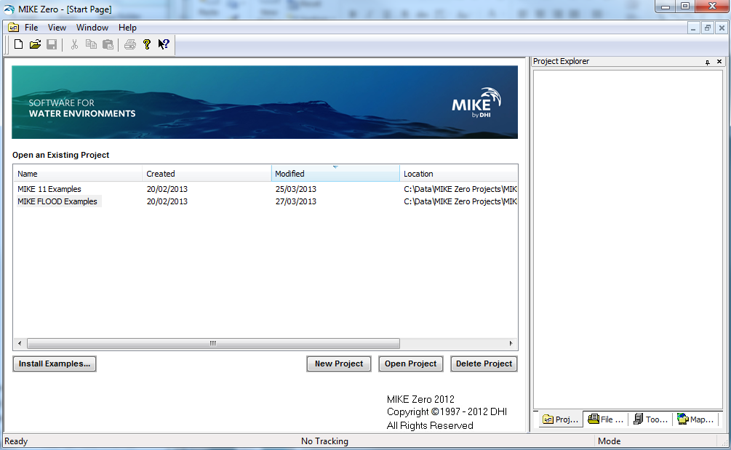
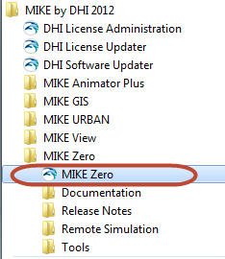
STARTING MIKE 11
From Start > All Programs > MIKE by DHI 20xx > MIKE Zero

